Slide 1
CS 2690 Computer Networks II Dr. Sayeed Sajal Lecture 15 XDR and ASN.1

Slide 2
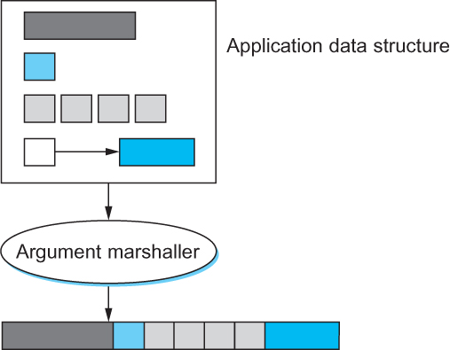
Figure 7.3 Argument Marshalling: Converting, Packing and Linearizing

Slide 3
Canonical Intermediate vs. Receiver-Makes-Right
Canonical intermediate form uses a network standard data format
Senders must convert from their native form to canonical intermediate (network standard) form, if they don’t already use that form
Receivers must reconvert from canonical intermediate back to their native form (which may or may not be different than the sender’s native form)
With receiver-makes-right, the sender does no conversion
Instead, the data is tagged with a standardized code that tells the receiver what native format the sender used
If the receiver’s native format is different, the receiver must do the conversion (i.e., must “make it right”)
Standards apply in both systems
In canonical intermediate, the data format is standardized
In receiver-makes-right, the tags must be standardized

Slide 4

A 32-Bit Integer Encoded as Tagged Data

Slide 5
External Data Representation Standards
Sun XDR (eXternal Data Representation)
ISO ASN.1 (Abstract Syntax Notation One)
OSF DCE NDR (Network Data Representation)
W3C XML (eXtensible Markup Language)

Slide 6
Sun’s Open Network Computing (ONC+) Environment

Slide 7
XDR Data Types
DATA TYPE | SIZE | DESCRIPTION
int | 32 bits | 32-bit signed binary integer
unsigned int | 32-bits | 32-bit unsigned binary integer
bool | 32 bits | Boolean value (false or true) represented by 0 or 1
enum | arb. | Enumeration type with values defined by integers (e.g., RED=1, WHITE=2, etc.)
hyper | 64 bits | 64-bit signed binary integer
unsigned hyper | 64 bits | 64-bit unsigned binary integer
float | 32 bits | Single precision floating point number
double | 64 bits | Double precision floating point number
opaque | arb.* | Unconverted data (i.e., data in the sender’s native representation)
string | arb. | String of ASCII characters (preceded by a 4-byte int count of number of elements)
fixed array | arb. | A fixed-size array of any other data type (no count field - length is predetermined)
counted array | arb. | Array in which the type has a fixed upper limit, but individual arrays may vary up to that size (preceded by a 4-byte int count of number of elements)
structure | arb. | A data aggregate, like C's struct
discriminated union | arb. | A data structure that allows one of several alternative forms, like C’s union
void | 0 | Used if no data is present where a data item is optional (e.g., in a structure)
symbolic constant | arb. | A symbolic constant and associated value
optional data | arb. | Allows zero or one occurrences of an item
*Size is arbitrary (variable)
From Internetworking with TCP/IP, Vol. III, D. Comer, Prentice Hall

Slide 8
XDR Encoding Operations in C
#include <rpc/xdr.h>
#define BUFSIZE 4000 /* size of memory for encoding */
XDR *xdrs; /* pointer to last byte in XDR stream */
char buf[BUFSIZE]; /* memory area to hold XDR stream (data) */
xdrmem_create(xdrs, buf, BUFSIZE, XDR_ENCODE); /* initialize stream */
int i; /* integer in local "native" representation */
. . . /* assume stream initialized for ENCODE */
i = 260; /* assign integer value to be converted */
xdr_int(xdrs, &i); /* convert integer and append to stream */
Adapted from Internetworking with TCP/IP, Vol. III, D. Comer, Prentice Hall

Slide 9
Files Produced by Compiling an RPC Specification File

Slide 10
Applications of Abstract Syntax Notation One (ASN.1)
Simple Network Management Protocol (SNMP)
X.509 digital certificates (“SSL certificates”)
Kerberos v5 (security server)
ASHRAE BACnet building automation & control protocol (HVAC, lighting, fire detection & access control)
Lightweight Directory Access Protocol (LDAP)
H.323 switching protocol (Voice over IP)
SS7 (landline network switching standard)
TCAP (cellular network switching standard)

Slide 11
The Domain of the ASN.1 Standard
(Network Communication)

Slide 12
ASN.1/BER Universal Basic Types
Basic Types
TYPE NAME | TAG* | SET OF VALUES
BOOLEAN | 1 | TRUE or FALSE
INTEGER | 2 | Positive and negative whole numbers including zero
BIT STRING | 3 | A sequence of zero or more bits
OCTET STRING | 4 | A sequence of zero or more octets (bytes)
REAL | 9 | Real numbers
ENUMERATED | 10 | An explicit list of integer values that an instance of a data type may assume
*These are Universal tags, recognized by all ASN.1-compliant systems

Slide 13

ASN.1/BER Representation Concepts
length
INT (2)
4-byte big-endian int
tag
Figure 7.8 ASN.1 BER representation for a 4-byte integer.

Slide 14
Defining Data Types Using Abstract Syntax Notation
ClassRank ::= -- comments are denoted by 2 hyphens
INTEGER {
freshman (0), sophomore(1), junior (2), senior (3)
}

Slide 15
ASN.1/BER Universal Object Types
Object Types
TYPE NAME | TAG | SET OF VALUES
OBJECT IDENTIFIER | 6 | A set of values associated with an ASN.1-defined information object (a registered numeric string that uniquely identifies an object, e.g. 1.3.6.1.2.1.4.3)
Object Descriptor | 7 | Human readable text describing a Type 6 information object, e.g. “ipInReceives”
NumericString | 18 | Digits 0 - 9, space
(...)String | 19-21 | Various strings, not widely used
IA5String | 22 | International alphabet 5 (ASCII)
(…)String | 25-27 | Various strings, not widely used

Slide 16
Part of the OBJECT IDENTIFIER Name Tree

Slide 17
ASN.1/BER Universal Miscellaneous and Structured Types
Miscellaneous Types
TYPE NAME | TAG | SET OF VALUES
NULL | 5 | A single value NULL. Used where several alternatives are possible but none of them apply.
EXTERNAL | 8 | A type defined in some external document. It need not be a valid ASN.1 type.
UTCTime | 23 | Date, time and UTC offset, specified as YYMMDDHHMMSS:Offset
GeneralizedTime | 24 | Date, time and UTC offset, specified as YYYYMMDDHHMMSS:Offset
[Reserved] | 11-15
[Reserved] | 28-
Structured Types
TYPE NAME | TAG | SET OF VALUES
SEQUENCE and SEQUENCE-OF | 16 | Sequence: references a fixed, ordered list of types; each value is an ordered list of values, one from each component type. Sequence-of: defined by referencing a single existing type; each value is an ordered list of zero or more values of the existing type.
SET and SET-OF | 17 | Set: defined by referencing a fixed, unordered list of types, some of which may be declared optional; each value is an unordered list of values, one from each component type. Set-of: defined by referencing a single existing type; each value is an unordered list of zero or more values of the existing type.

Slide 18
Defining an ASN.1 Data Type Using a SEQUENCE
A-PDU-Example ::= -- This PDU has 3 fields
SEQUENCE { -- that are always present
version INTEGER,
protocol-name IA5STRING, -- ASCII char string
flags BIT STRING {
final-fragment(0), ack(1)
}
}
Figure 7.7 (modified) Compound types created by means of nesting in ANS.1 BER (transfer syntax).

Slide 19
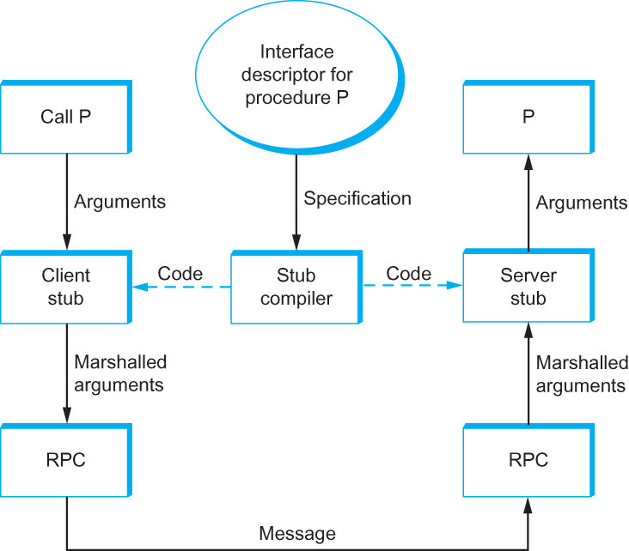
Figure 7.5 ASN.1 Stub Compiler
FIGURE 7.5 Stub compiler takes interface description as input and outputs client and server stubs.

Slide 20
Quiz Next Time
Covers text pp. 431 - 587 (just what was assigned), which includes RPCs and Presentation Formatting (including big and little endian); and lectures 12 - 15. (No ASN.1 questions.)

Slide 21
Homework Question B
B. Give the ASN.1 transfer syntax encoding for the following data types and values. Show integer data values in hex (not binary) format and show characters as text characters. Assume that the integer value is stored in a 4-byte field. Use Figures 7.7 and 7.8 on p. 590 and the relevant Lecture 15 slides as a guide. (10 points)
a) The integer 10,120
b) The ASCII text string “Text”
c) A SEQUENCE containing the data items in (a) and (b), as follows:
Part-c ::=
SEQUENCE {
myint INTEGER ::= 10120,
mytext IA5String ::= "Text"
}

